Slide 1
LOW-INCOME, AFFORDABLE & ATTAINABLE HOUSING
IN DOWNTOWN COLORADO SPRINGS

Slide 2
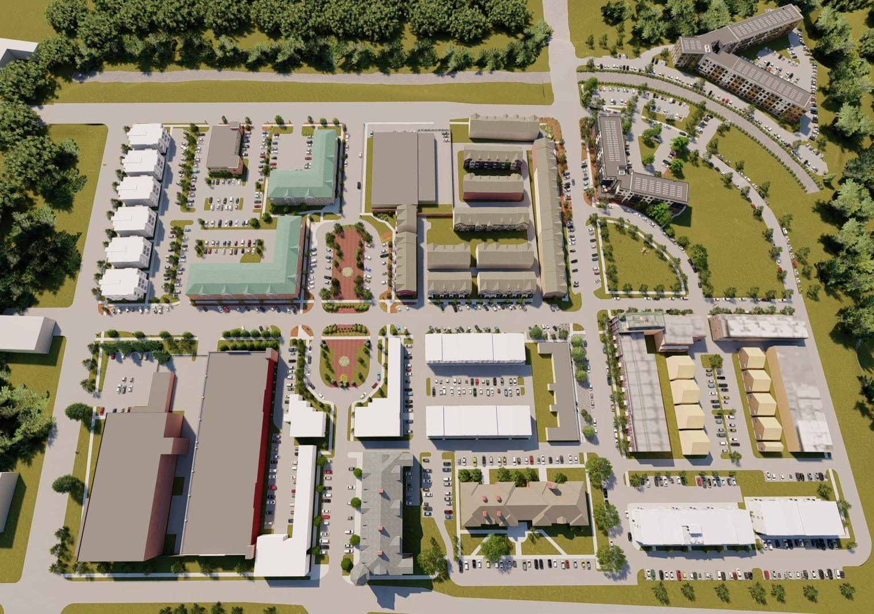
04.22.2021
THE LOWELL NEIGHBORHOOD
DRAPER COMMONS
LOWELL COMMONS

Slide 3
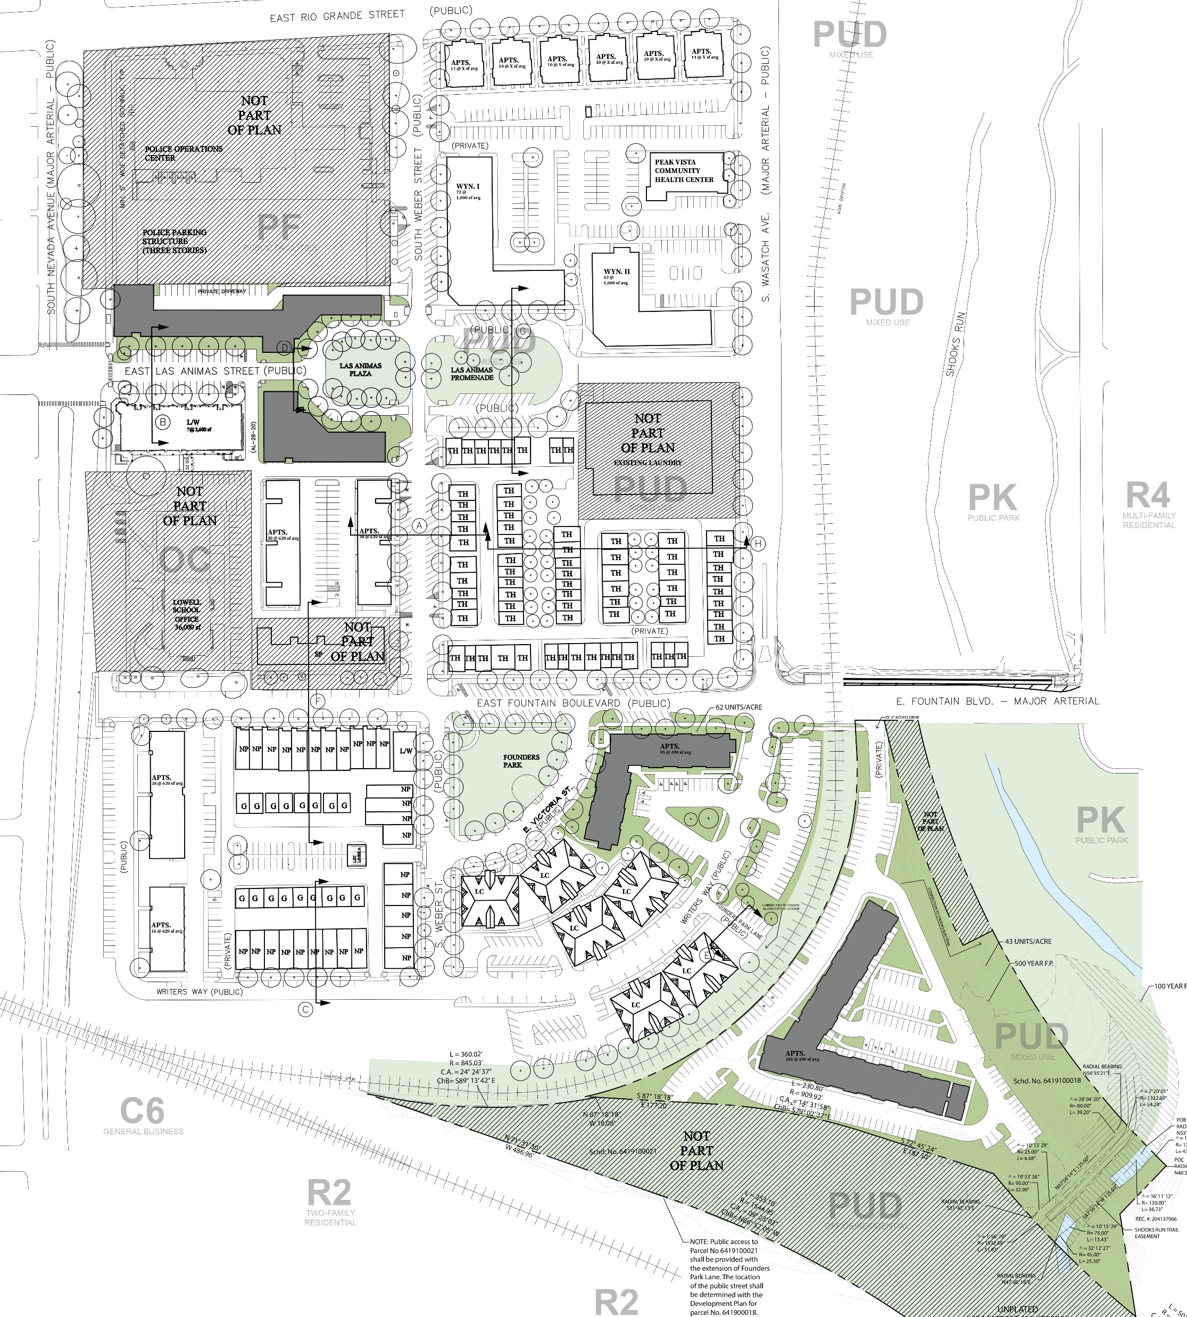
THE LOWELL NEIGHBORHOOD
LOWELL COMMONS
DRAPER COMMONS

Slide 4
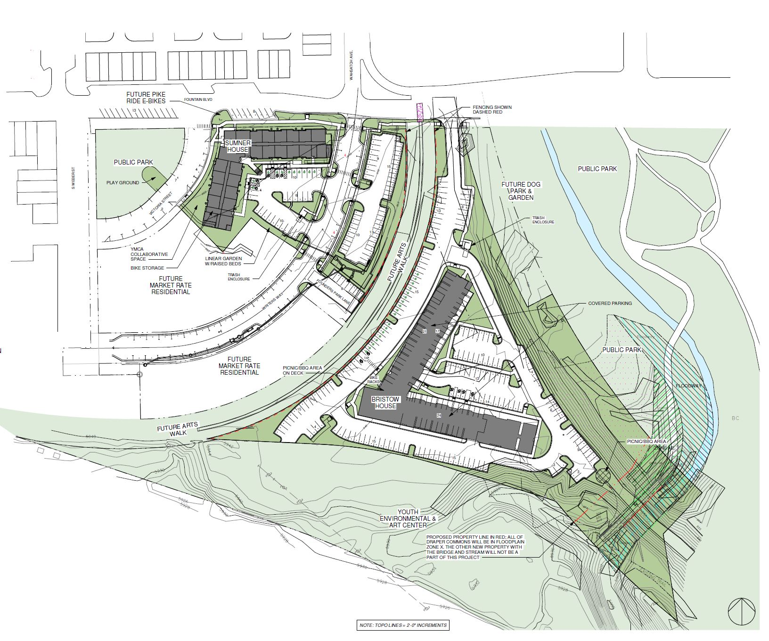
DRAPER COMMONS SITE PLAN

Slide 5
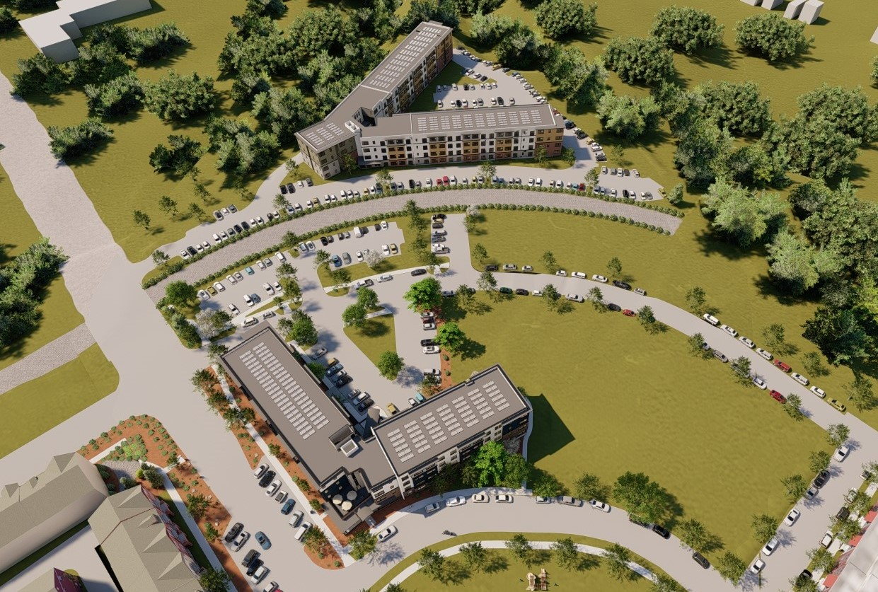
04.22.2021
DRAPER COMMONS
BRISTOW HOUSE
SUMNER HOUSE

Slide 6
04.22.2021
SUMNER HOUSE

Slide 7
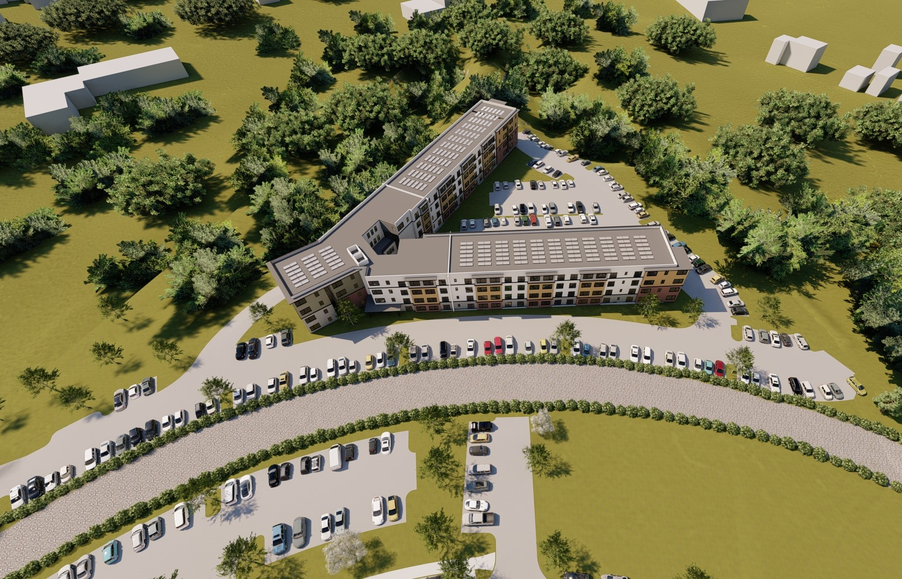
04.22.2021
BRISTOW HOUSE

Slide 8
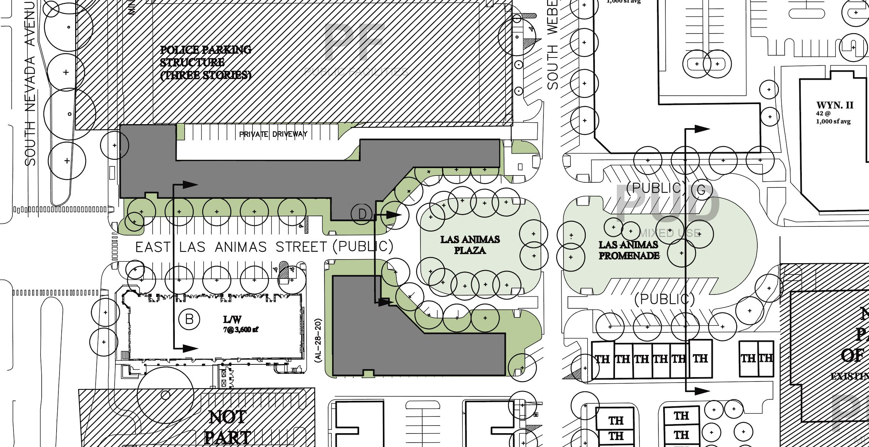
LOWELL COMMONS SITE PLAN

Slide 9
LOWELL COMMONS

Slide 10
PROJECT INITIATIVES
Provide long-term quality low-income and workforce housing for downtown Colorado Springs. 280 Units will serve the 30-60% AMI level with 180 units serving the 70-140% AMI level. Secured by long term land use restriction.
Designed for affordable accessible housing going above and beyond the minimum design building code for seniors and people with disabilities. 100% of the project will be either ADA accessible or ADA compliant.
The design of the community has been guided by the Innovations in Aging Collaborative and the Independence Center. For over 2 years the Quad Innovation Partnership has gathered global best practices in intergenerational housing. Those concepts have been baked into the design of this project.
The project will be close to Net Zero on carbon emissions. It will have a large PV solar array, electric charging stations for cars, be bike and walk friendly and have high efficiency HVAC. The project is in close proximity to parks, trails, public transit and downtown Colorado Springs. The project will be Silver Level of the National Green Building Standards.

Slide 11
UNIT MIX, RENTS & MARKET STUDY
DRAPER COMMONS:
LOWELL COMMONS:
Units range from $865 / month - $1995 / month
60-140% ami

Slide 12
04.22.2021
UNIT PLANS
A
2 BED / 1 BATH
B
1 BED / 1 BATH
C
STUDIO / 1 BATH

Slide 13
PUBLIC IMPROVEMENTS
Community Room
280 Units 100% Low-income, 180 Units 100% workforce housing
Surrounded by parks and connected to the legacy loop
Security cameras
Criminal and Credit background checks for all residents
100% ADA friendly
Downtown
Bike repair shop and indoor and outdoor storage
Public Art

Slide 14
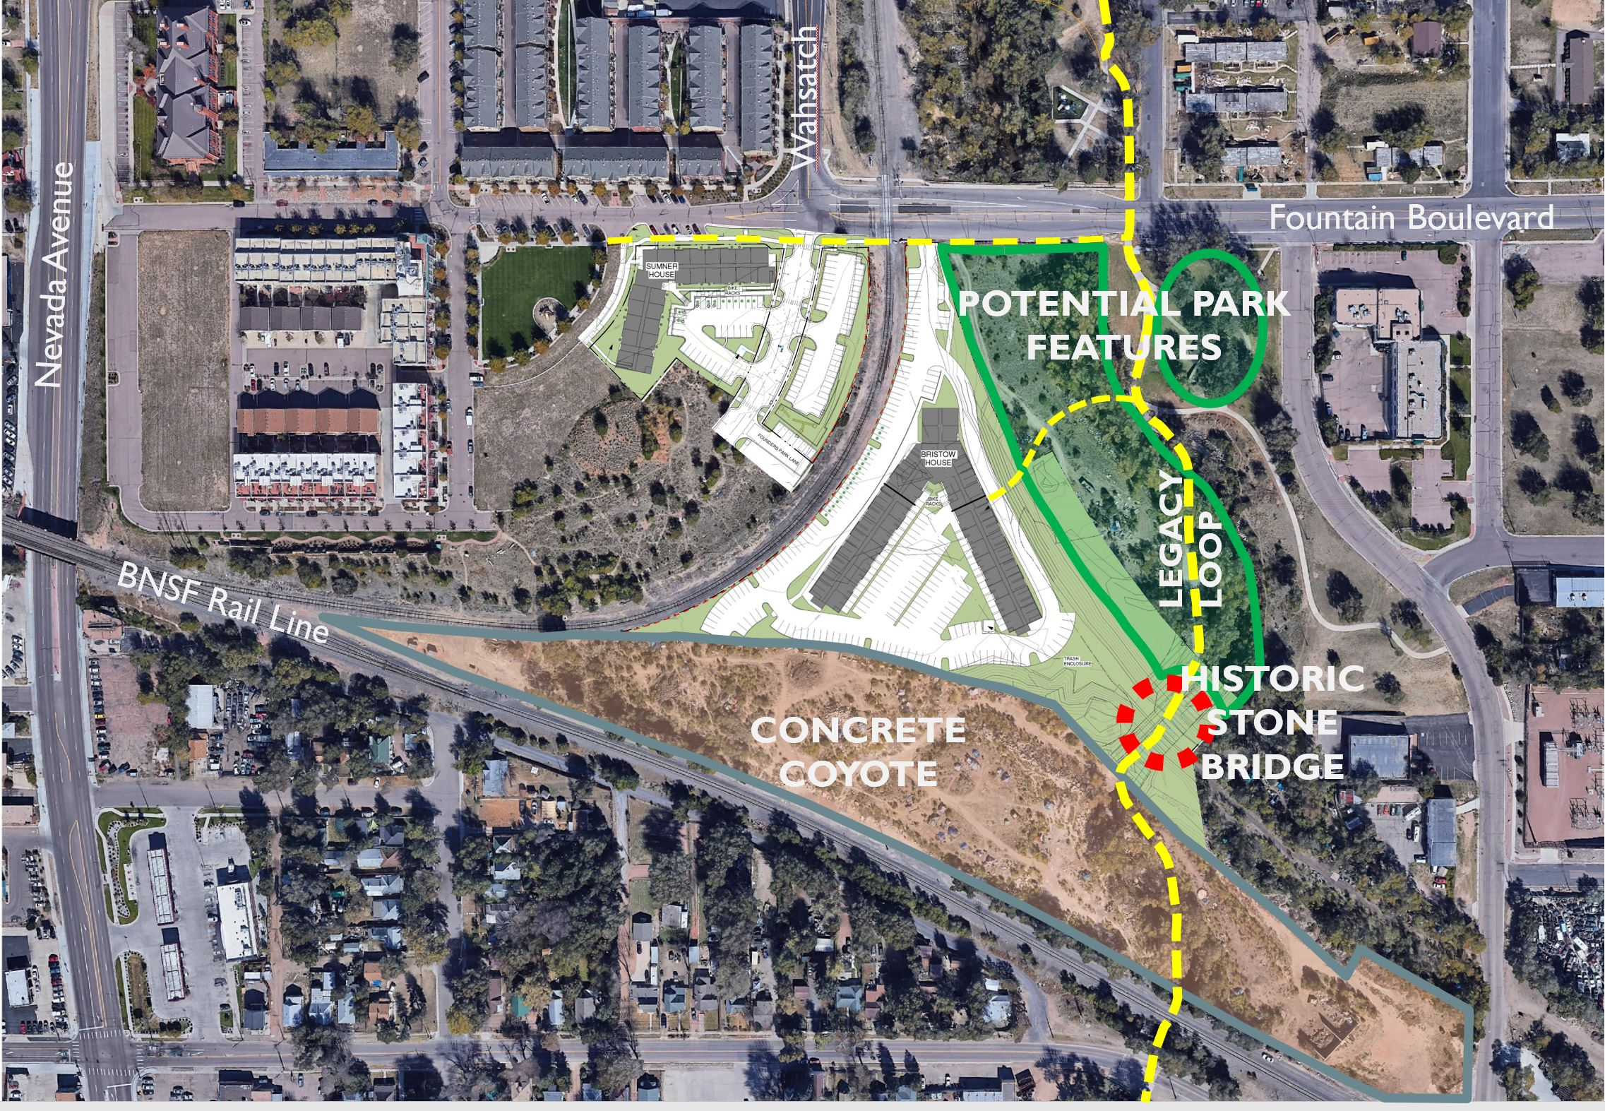
PARKS AND THE LEGACY LOOP

Slide 15
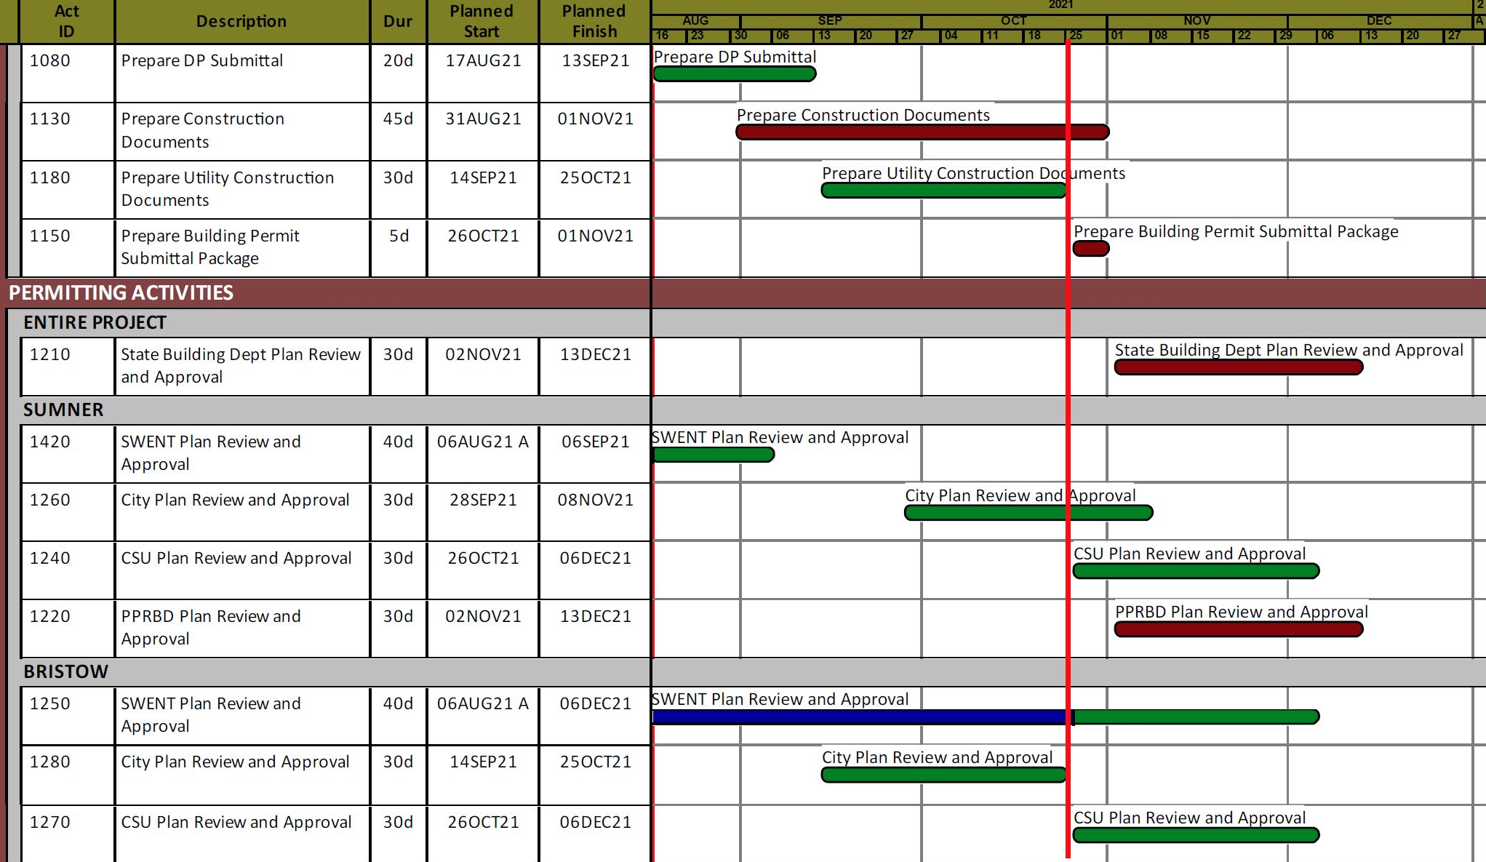
PROJECT TIMELINE
DRAPER COMMONS:
By using modular construction systems, construction for Draper Commons is expected to take 9-10 months
LOWELL COMMONS:
Lowell Commons will follow 12 months behind Draper Commons

Slide 16
COMMUNITY INVOLVEMENT
RAPID RESPONSE
The R and R Foundation
We want to be a community partner in addition to providing housing. We want to provide a place to meet, gather, and connect people to the community through jobs, social networking and empowering people to be self-sufficient by providing housing as the cornerstone.

