Slide 1
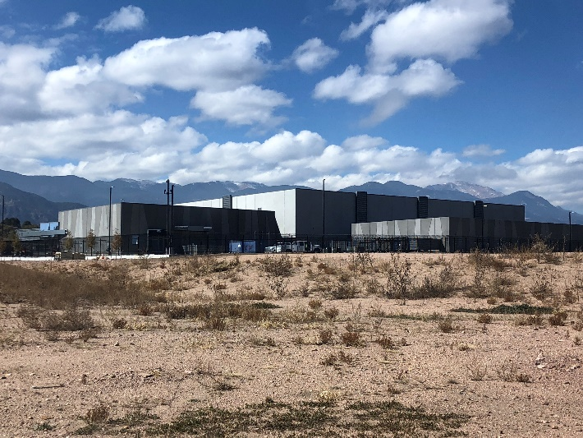
PRESENTATIONFOR
Colorado Springs Urban Renewal Authority
status of development progress
T5@Colorado Data Center Campus
May 2020

Slide 2
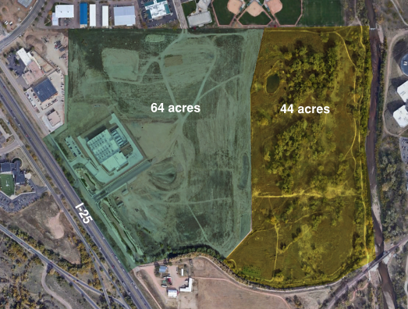
PROJECTOVERVIEW
64 Acre Land Development
Dedicated to Data Center facilities
Purchased Land
2009 Annexed Land
2012 TIF Agreement Executed
Agreement w/ IronPoint Partners
2017 Land Sale to SAP
2019 SAP Data Center Occupied

Slide 3
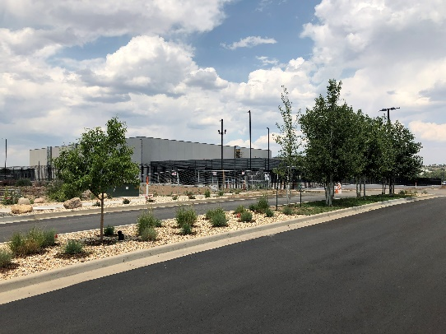
DEVELOPERIMPROVEMENTS
12” CSU waterline extension under 1-25
Site grading completed
39MW enhanced powered delivered
Regional stormwater facilities constructed
Roadways and entries constructed
Site security facilities
Enhanced telecom facilities delivered

Slide 4
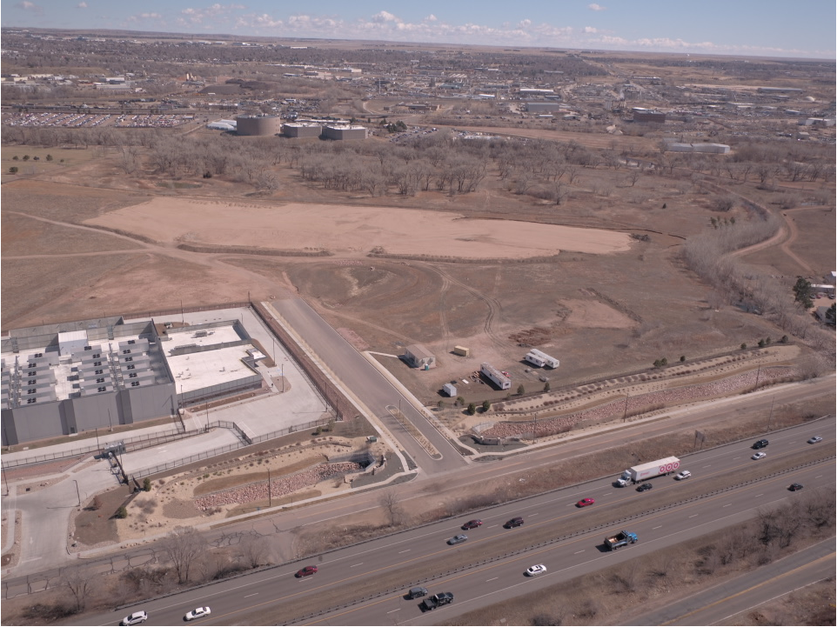
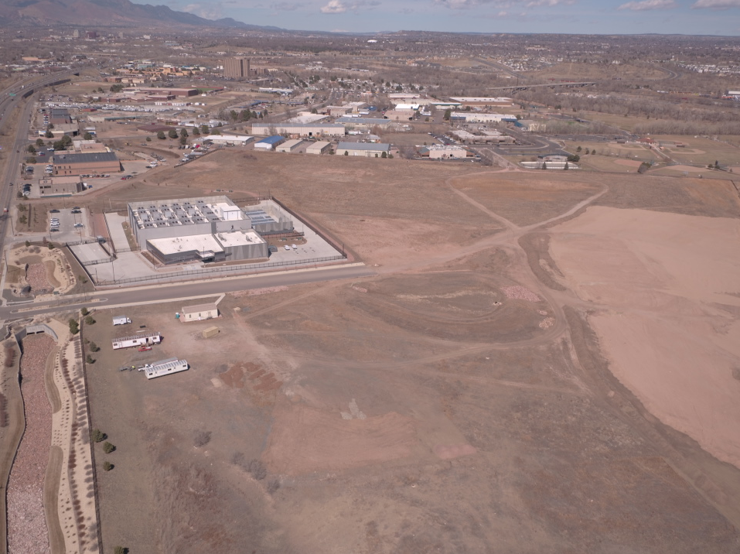

Slide 5
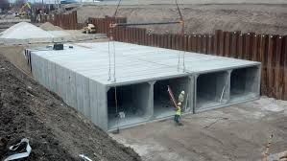
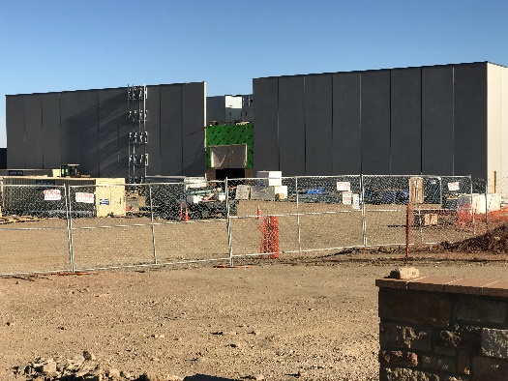
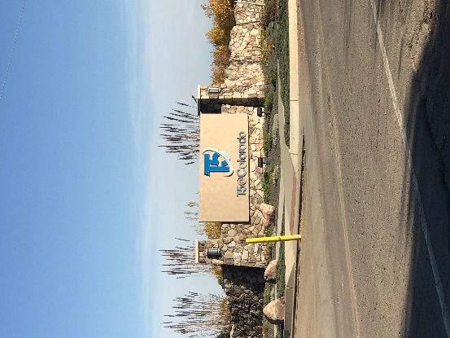
DEVELOPERIMPROVEMENTS
Direct Impact from Development To Date:
$88M in Construction Revenue from SAP development
$14M in Construction Revenue from Park development
Approximately $850k/year in Operating Revenue annually from development
Approximately $300k/year in Operating Revenue annually from park maintenance
Does not include secondary and tertiary impacts
Does not include impact from energy sales

Slide 6
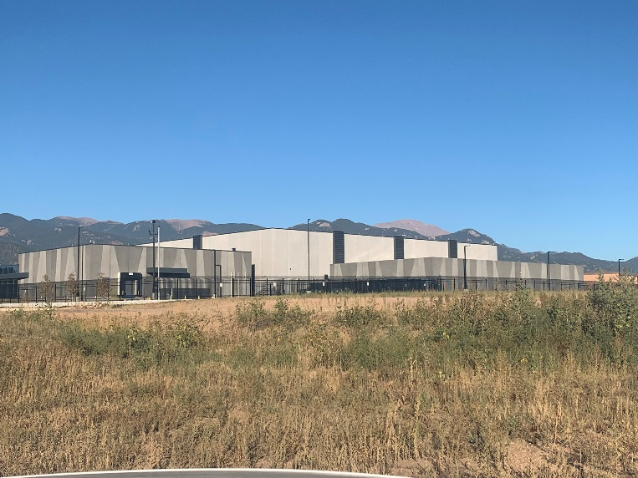
DEVELOPERIMPROVEMENTS
Tax Increment To Date of $1.4M from Base Year
2020
$800,000

Slide 7
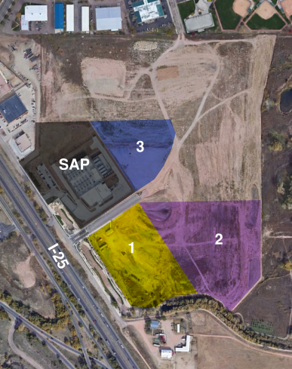
PENDINGDEALS
1. 8 acre, 3MW DC – Phase 1 of 2 IN DESIGN
$75M Development Cost
$70M in Hardware and Software
2. 15 Acre Land Sale/Development Deal IN NEGOTIATION
$210M Development Cost
$175M in Hardware and Software
3. 7.5 Acre Development Deal APPROVED
$120M Development Cost
$80M in Hardware and Software
the values stated above are estimates only and are approximate only

Slide 8
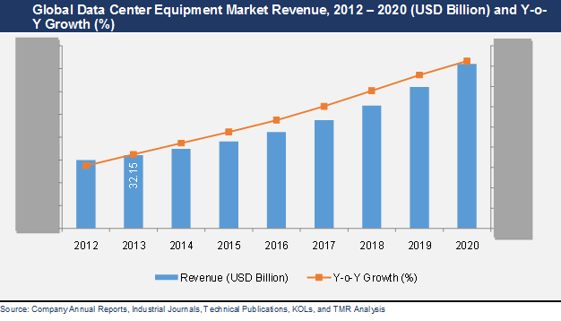
MARKETTRENDS

Slide 9
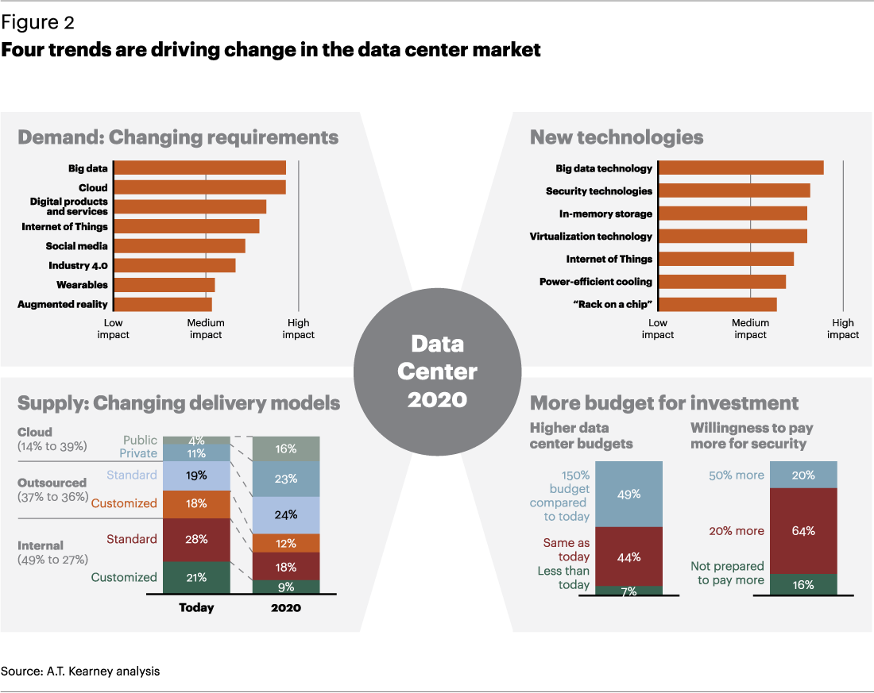
MARKETTRENDS

Slide 10
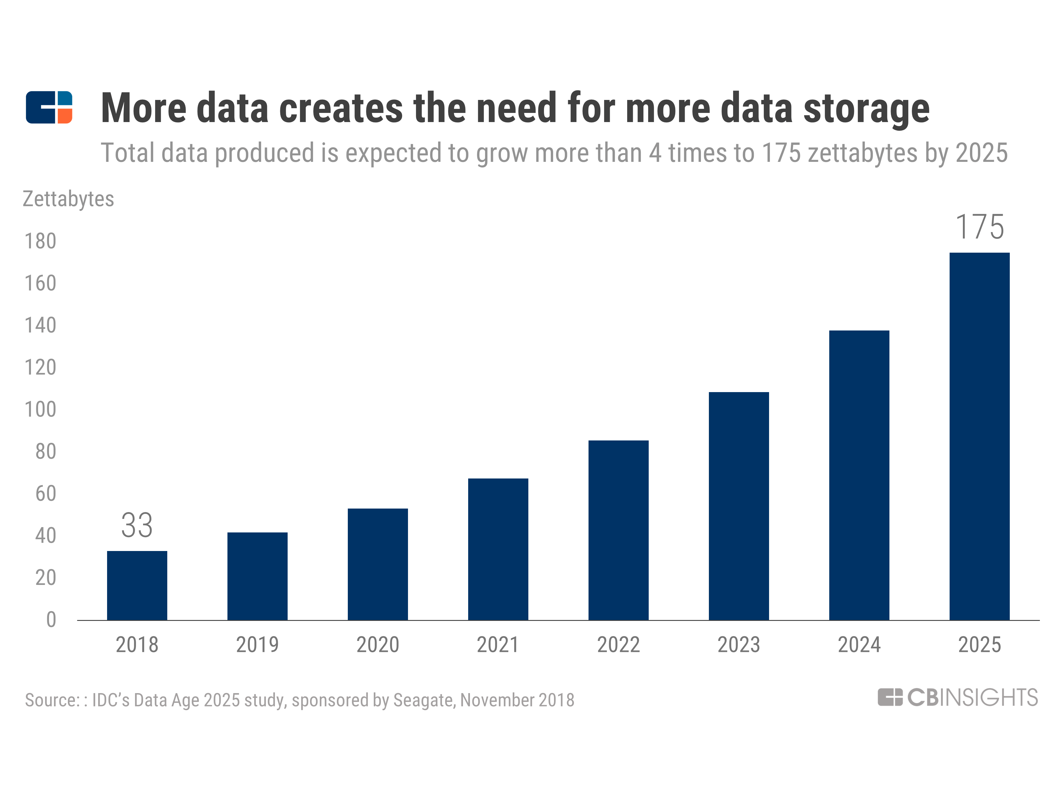
MARKETTRENDS

Slide 11
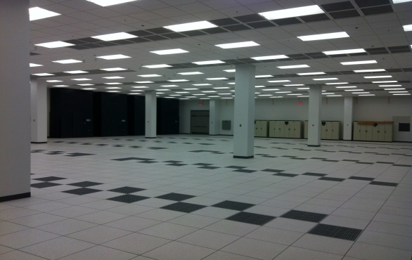
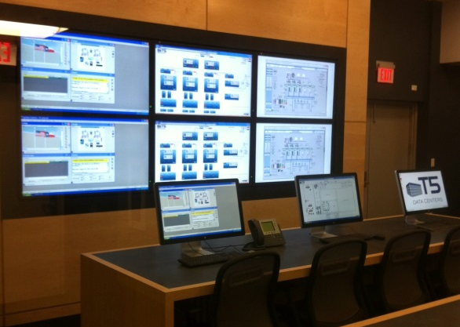
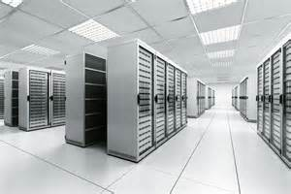
MARKETTRENDS
Market Influencers:
Internet of Things (IOT)
Secured Environments
Artificial Intelligence
Hyper Cloud
5G Technology
Distributed Resiliency

