Slide 1
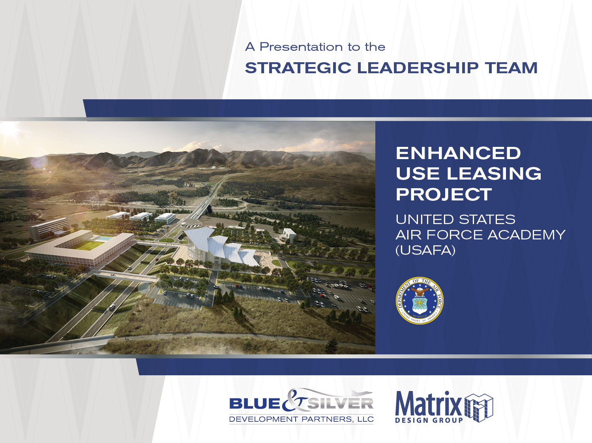
Urban Renewal Authority
July 25, 2018
An Interview Presentation

Slide 2
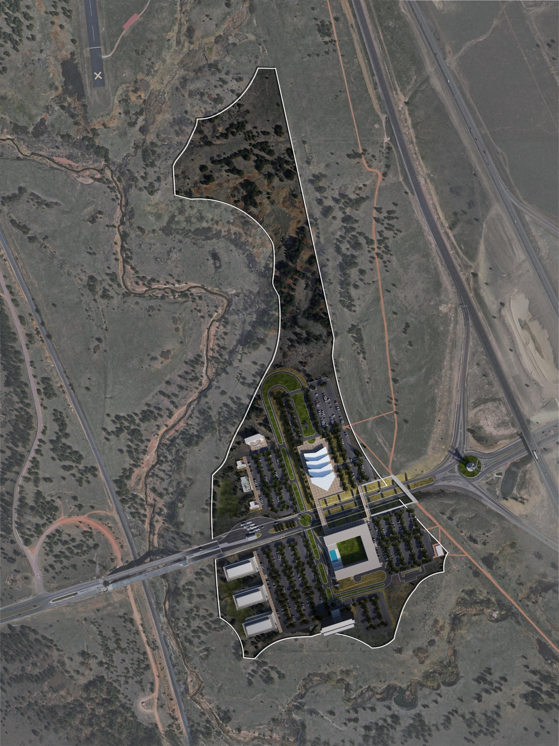
Land Use Summary
Land Use | Site Area (acres) | GFA – Achieved (sf)
Visitors Center | 8.0 | 36,971
Hotels (2) | 11.0 | 84,600
Commercial Retail | 6.0 | 22,000
Office | 9.0 | 120,000
Public Infrastructure | 4.0
Future Development | 19.0
North Gate Site Totals | 57.0 | 263,571

Slide 3
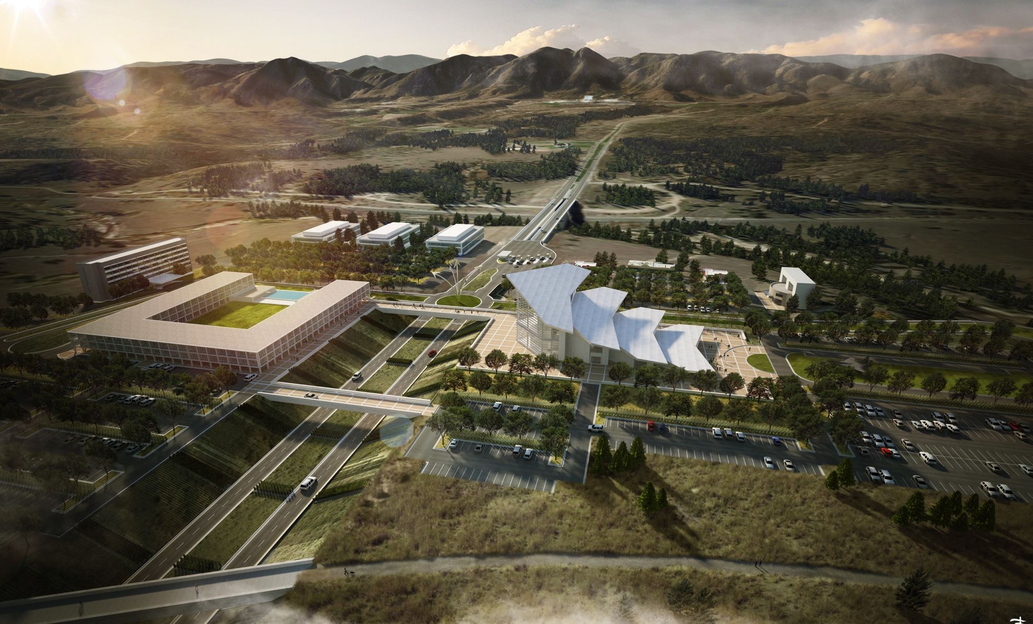
Land Plan Graphic

Slide 4
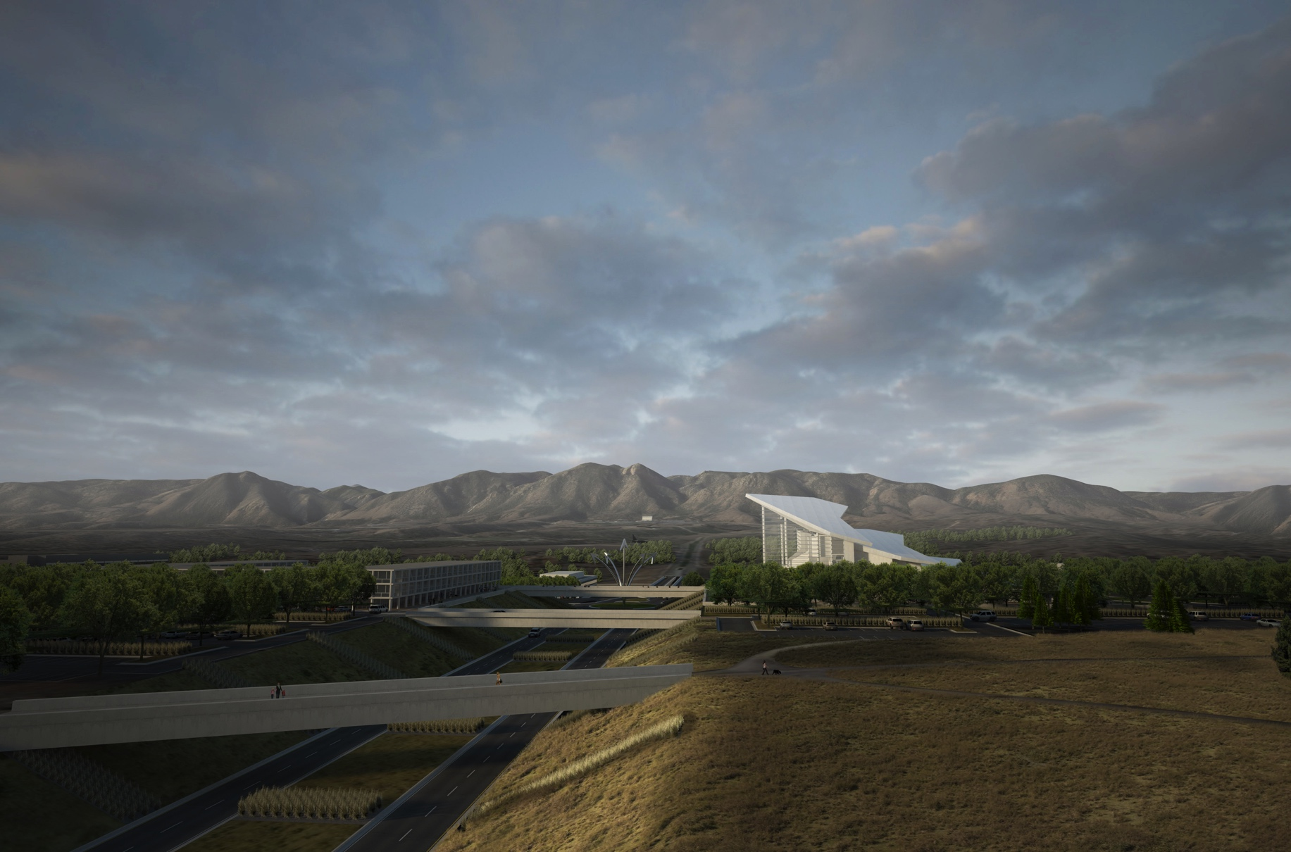
View from I-25

Slide 5
Project Federal Authority
SUB HEADING
Enhanced Use Lease
  Governed By US Title 10 Section 2667 – allows for a lease of federal land in exchange for the development of an unfunded federal need on underutilized federal property
  The Airforce Academy seeks a new Visitor’s Center and is providing approximately 60 acres of Academy Property at the North Gate and I-25 for commercial development
  Blue & Silver Development Partners LLC is negotiating a Master Developer and Ground Lease with the Air Force as the selected Qualified Lessee.
Finance Approach
  The development will require private equity, debt and public finance to be successful
  Title 31 Business Improvement District (BID) requirements for a public finance approach will be applied in the development of the project

Slide 6
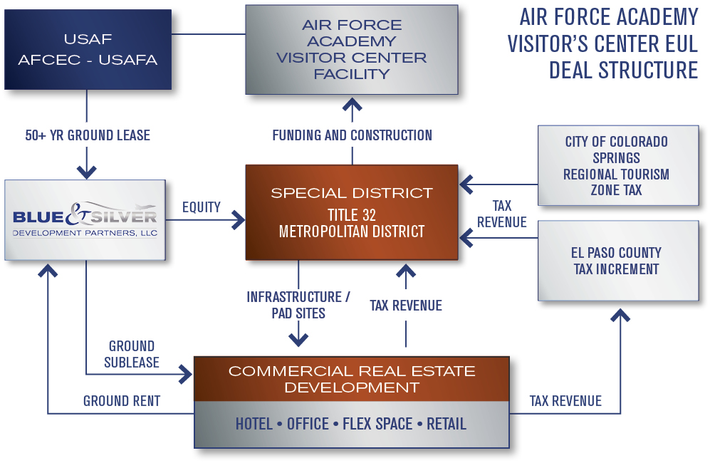
EUL Deal Structure
Deal Structure
TITLE 31
Business Improvement District

Slide 7
Development & Funding Milestones
Annexation Petition Submitted 07-23-2018
BID Approved 07-24-2018
URA Application Submittal 08-03-2018
RTA Commencement of Substantial Work 12-16-2018
Annexation Approval 12-2018
URA Approval 01-2019
Public Bond Offering 04-2019
Public Infrastructure Construction 05-2019 to 08 2019
Commercial Development Begins 09-2019
Visitors Center Design 03-2018 to12-2020
Visitors Center Construction 01-2021to 01-2023
RTA Final Completion Date 12-16-2023

Slide 8
Project BID Development Costs
Air Force Academy Visitor’s Center - $34 MM
  38,000 square foot Visitor’s Center
  Parking lots, lighting and landscape
  Polaris Prominade
Public Infrastructure - $18 MM
  Transportation Infrastructure – Roads, Ped. & Veh. Bridges
  Water and sanitary sewer systems
  Storm water facilities and channel improvements
  Power, gas and telecommunications

Slide 9
Conceptual Opinion of Probable
Construction Costs

Slide 10
Conceptual Opinion of Probable
Construction Costs

Slide 11
USAF ACADEMY VISITOR DISTRICT FINANCING PLAN
($100+ MILLION HOTEL/OFFICE/RETAIL PRIVATE INVESTMENT)
USAF ACADEMY VISITOR DISTRICT FINANCING PLAN
(Over $100 MILLION HOTEL/OFFICE/RETAIL PRIVATE INVESTMENT)
REGIONAL TOURISM TAX
CITY OF CHAMPIONS USAF VISITOR CENTER
Up to $13 million nominal value
USAF ACADEMY VISITOR CENTER
$34 million
BUSINESS IMPROVEMENT DISTRICT
Capital Construction—up to 50 mills
O&M—up to 10 mills
PIF—up to 2%
STREETS AND UTILITIES
$18 million
CITY URA/TAX INCREMENT
Sales Tax—up to 2%
Property Tax—up to 57 mills
Lodging Tax—up to 2%

Slide 12
Robust Developer Interest

Slide 13
Letters of Interest and Prospective Tenant Interest and Activity Report-cont.

Slide 14

Questions & Discussion
Dan Schnepf
President and Managing Member
Blue & Silver Development Partners, LLC
(719) 238-4888
Eric Smith
Director of Development
Blue & Silver Development Partners, LLC
(719) 338-2388

